Slide 1

ZERO TRUST
Never Trust, Always Verify
Presented at
Linkedn https://in.linkedin.com/in/piratesshield
Bangalore Chapter

Slide 2

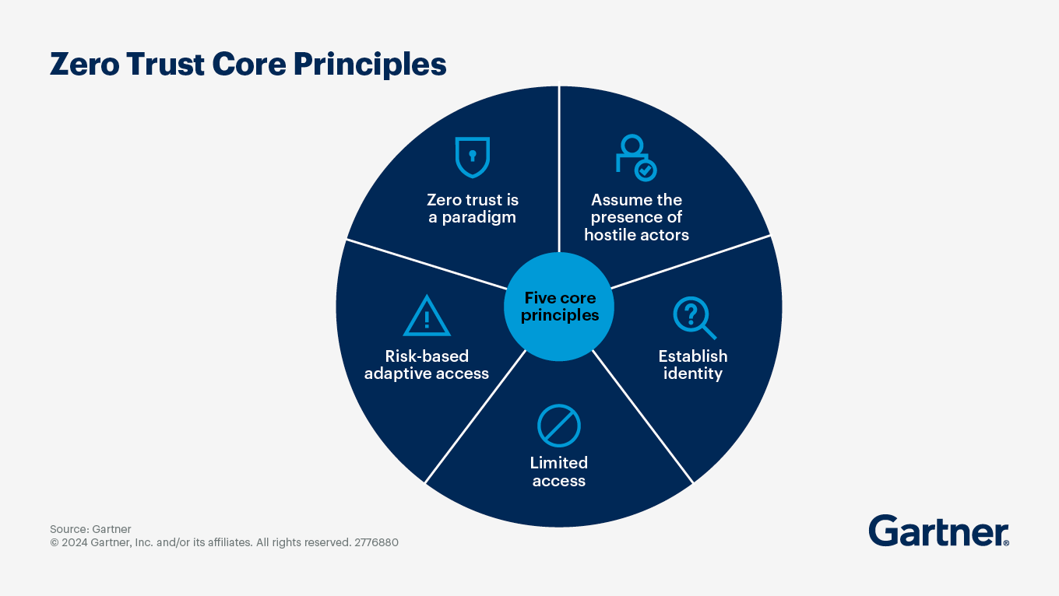
What is Zero Trust Security ?
Zero Trust Security, as outlined by Gartner, redefines traditional trust paradigms by rejecting default trust based on network perimeters. It mandates continuous verification and authentication of users, devices, and applications accessing resources, irrespective of their network location, through factors like identity, device health, and resource sensitivity. Key principles include verifying identity, enforcing least privilege access, assuming breach, implementing micro-segmentation, and enabling continuous monitoring to promptly detect and respond to threats. This model aims to minimize the attack surface, prevent lateral movement of threats, and safeguard sensitive data from unauthorized access, thus bolstering overall cybersecurity posture.
Definition (NIST SP 800-207):
'Minimizes uncertainty in enforcing least privilege access decisions in a compromised environment.'
• No implicit trust – Always verify identity and access
• Shift from perimeter-based security to identity-based security

Slide 3
Why not NIST , Why Zero-trust
NIST (Operational):
Risk management framework (Identify, Protect, Detect, Respond, Recover)
Provides guidelines, not real-time enforcement → Reactive approach
Zero Trust (Strategic):
"Never Trust, Always Verify" – No implicit trust
Strict identity verification and least privilege access → Proactive approach
Continuous monitoring to prevent lateral movement
Why Zero Trust Over NIST?
NIST defines what to do; Zero Trust defines how to do it with real-time controls
More security-focused – Blocks advanced threats (ransomware, insider attacks)
Reduces attack surface and minimizes damage from internal threats

Slide 4
Why is Zero Trust necessary?
The old approach of securing the network perimeter and trusting authenticated users has become outdated due to changes in how businesses operate and how cyber threats have evolved
Ineffective Security concepts | Why
Perimeter-based security | Internal threats bypass traditional perimeters
Implicit trust | Trusting authenticated users leads to lateral movement
Signature-based antivirus | Malware evolves faster than updates
Manual threat response | Too slow for modern attacks
Annual Compliance Check , Configuration audit and penetration tests | Threats change daily
“Cybersecurity is a Ninja art, where each technique has its own flaw”

Slide 5
Ineffective Security concept is Failure
ineffective Security concepts | Example of Failure | Why | Attack Pattern | Entry Point / Reason of the breach
Implicit trust | - Uber breach (2022): MFA fatigue attack compromised admin credentials, giving attackers access to internal systems and sensitive data. | Trusting authenticated users leads to lateral movement. Attackers exploit this to escalate privileges and access sensitive systems. | - Credential Stuffing - Social Engineering - MFA Fatigue Attack | Multi-factor authentication (MFA) request spam using Duo Security.
Third-party / Device trust | - Disney breach (2024): Employee downloaded malware disguised as an AI tool, leading to the theft of 44M+ messages and sensitive data. | Employees and organizations often trust third-party software and services without proper vetting. Attackers exploit these weak points to bypass internal security. | - Supply Chain Compromise - Phishing | AI tool downloaded from an untrusted source (tool name not disclosed). - Stored credentials in the personal laptop - No continuous SSPM - No security posture check

Slide 6
Zero Trust Pillars
A Zero Trust Pillar is a foundational component that supports the Zero Trust security model .Which is maximum structured around seven core pillars that cover different aspects of an organization's security architecture. Each pillar defines a specific area that needs to be secured and continuously monitored to minimize attack surfaces and limit lateral movement.
1.Data Lifecycle
Management
2. Data Security
1. Asset Management
2. Device Classification
3. Endpoint Security
4. Device Authentication and Access Control
5. At Rest Encryption
1. Authorized Application Catalog
2. Software Development Life Cycle (SDLC)
3. Software Risk Management
4. Resource Authorization & Integration
1.Authentication
2.Authorization
3.User and Entity Behavior Analytics (UEBA)
4.Continuous Authentication
5.Dynamic Policy Enforcement
1. Micro-segmentation
2. In-Transit Encryption
3. Zero Trust Network Access (ZTNA)
4. Network Segmentation and Isolation(VLAN)
1.Automate the Security process flows (E.g. IRR)
2.Automate Configuration Audit
3.Automate SOC / SOAR
4.Orchestrate all the Security Controls
5. Implement the Mesh Arch.
1. Network Visibility
2. Endpoint Security Health Monitoring
3. User Activity Monitoring
4. Data Visibility
5. Cloud Visibility
6. Logging and Auditing
7. Cyber Threat intelligence Automation
8. Behavioral Analytics
9. Incident Response Automation
10. Continuous Improvement
11. SSPM / CSPM / DSPM
Identity
Device
Network
Application
Data
Automation & Orchestration
Visibility , Monitoring & Analytics

Slide 7
Laying the Foundation for a Successful Zero-Trust Strategy
Define Strategy and Principles: Clarify your organization’s zero-trust goals and guiding principles by aligning them with the core pillars of zero trust.
Identify Risks: Pinpoint the threats you aim to mitigate, aligning them with zero trust pillars such as network segmentation, least privilege access, and continuous monitoring to prevent issues like lateral movement and ransomware spread.
Set Scope and Targets: Define the boundaries of your zero-trust implementation, identify key areas for the initial rollout, and assess existing technology to uncover gaps and redundancies. Develop a clear roadmap to guide the phased deployment and ensure alignment with business objectives.
Secure Funding: Ensure the necessary budget is allocated to support zero-trust implementation.
Understand Business Processes: Be prepared to adapt, modify, or retire processes to enhance zero-trust effectiveness.

Slide 8
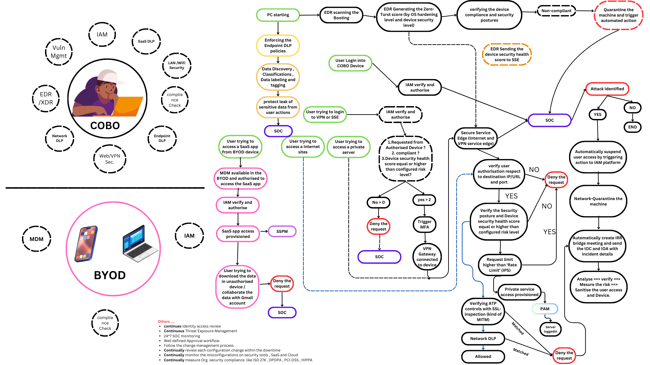

Slide 9
Others ....
continues Identity access review
Continuous Threat Exposure Management
24*7 SOC monitoring
Well defined Approval workflow
Follow the change management process .
Continually review each configuration change.
Continually monitor the misconfigurations on security tools , SaaS and Cloud
Continually measure Org. security compliance like ISO 27K , DPDPA , PCI-DSS , HIPPA

Slide 10
Cons.:
Implementation Complexity: Transitioning requires significant architectural changes and integration with existing legacy systems.
High Costs: Investment in new technologies, tools, and ongoing management can drive up both CAPEX and OPEX.
User Experience Challenges: Constant verification and micro-segmentation may lead to increased friction and reduced productivity.
Operational Overhead: Continuous monitoring and granular policy enforcement demand more robust management and skilled personnel.
Cultural Resistance: Shifting to a zero trust mindset often encounters internal pushback and requires substantial change management.
These factors should be carefully weighed against the security benefits when considering a zero trust strategy.

